Slide 1
Analytical CRM Development for a Bank
Submitted by:
Tanupriya Awasthi
8/11/2024

Slide 2
AGENDA
Problem Statement
Data Description
Objective Key Metrics and Visualizations
Subjective Question for Insights

Slide 3
Problem Statement
You are an analytical CRM (Customer Relationship Management) specialist hired by a bank to extract meaningful insights from various customer-related datasets. The bank aims to reduce customer churn, improve service delivery, and enhance customer satisfaction. They have provided you with datasets including customer demographics, transaction details, customer exit information, and active customer profiles.

Slide 4
Methodology
We have first analyzed the problem statement and then the data.
We have used SQL to answer various questions. In SQL we have used different commands like select, group by, order by, joins, window function, right(), update and alter.
In power BI we have created the Calculated columns, used DAX function to create measures, have applied conditional formatting and slicers to the dashboards.
We have used Power BI to create various charts and to prepare a dashboard.
We have also found the discrepancy in IsActiveMember column which we removed by creating a calculated column where we used if function to do so.

Slide 5
Data Description
In our data the following details are present :
CustomerId: A unique identifier for each customer.
CreditScore: A numerical representation of the customer's creditworthiness.
Credit score:
Excellent: 800–850
Very Good: 740–799
Good: 670–739
Fair: 580–669
Poor: 300–579
GeographyID: A numerical identifier that likely corresponds to a geographical location, such as a country or region.
GenderID: A numerical identifier for the customer's gender, where for example, '1' could represent male and '2' could represent female.
Age: The age of the customer.
Tenure: The number of years the customer has been with the bank.
Balance: Current balance in the customer's account.

Slide 6
NumOfProducts: refers to the number of products that a customer has purchased through the bank.
HasCrCard: denotes whether or not a customer has a credit card. This column is also relevant, since people with a credit card are less likely to leave the bank.
1 represents credit card holder
0 represents non credit card holder
IsActiveMember: active customers are less likely to leave the bank (as per the criteria defined by the bank for identifying the activeness).
1 represents Active Member
0 represents Inactive Member
Estimated Salary: as with balance, people with lower salaries are more likely to leave the bank compared to those with higher salaries.
Exited: whether or not the customer left the bank.
0 represents Retain
1 represents Exit
Bank DOJ: date when the Customer associated/joined with the bank.

Slide 7
Churn Rates
Customer churn is the rate at which customers stop using a company's products or services, is a crucial metric for banks.
The churn rate directly impacts revenue and profitability.
Here, we will analyze our bank's customer churn rates, focusing on gender, recent years, customers with credit cards, number of products used, credit score-wise churn count, and geography-wise churn count.

Slide 8
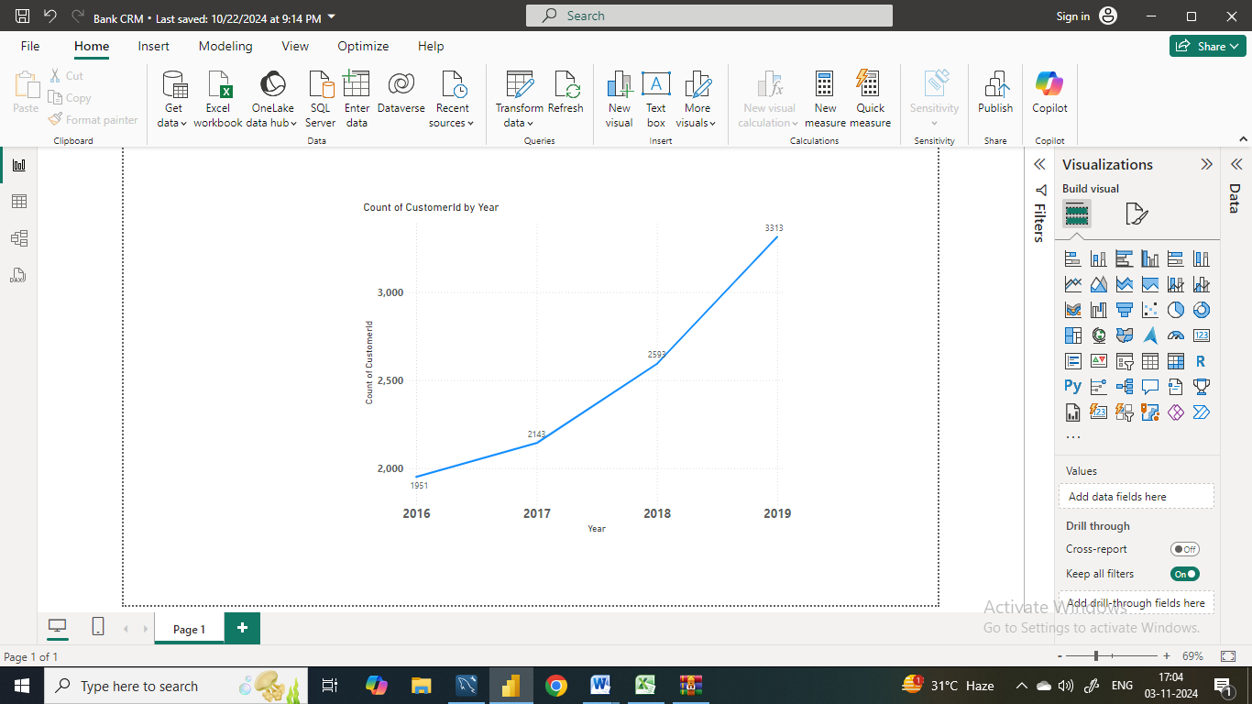
Customers Acquisition over the Years
Here we can that there is steady increase in the number of customers over the years.

Slide 9
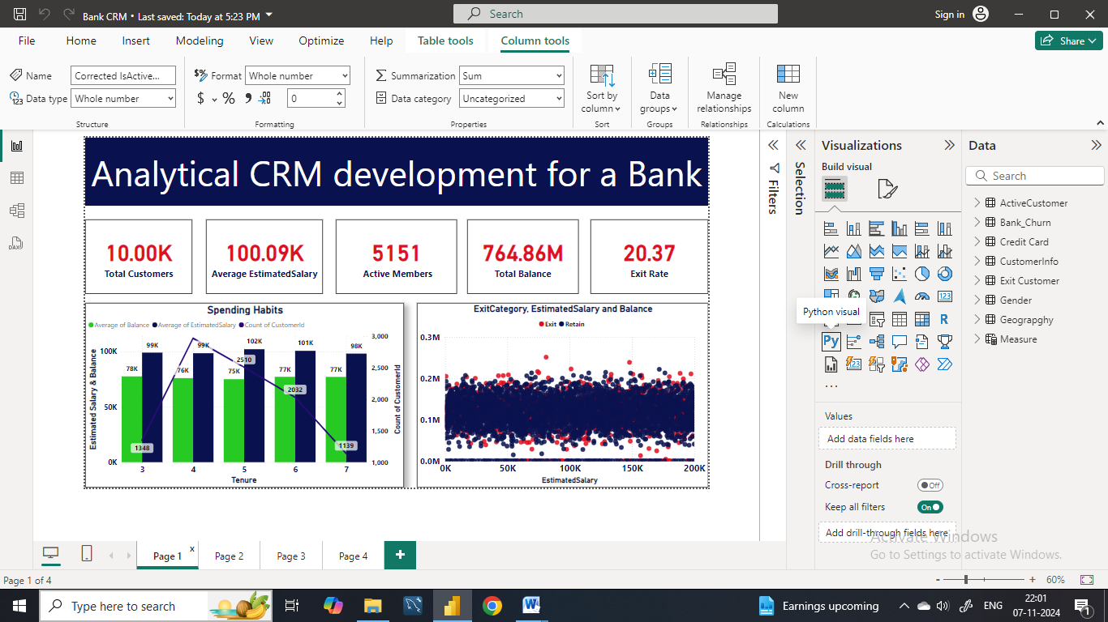
Customer Behavior Analysis
Financial stability and tenure:
There is a hike in the 4th tenure but it gradually it has started decreasing.
Targeted Engagement: The higher spending capacity of customers with 3–5 years of tenure suggests they may be a valuable segment for targeted engagement strategies.
Longer-tenured customers may demonstrate higher earning potential, customer retention efforts should not overlook the needs of newer customers.

Slide 10
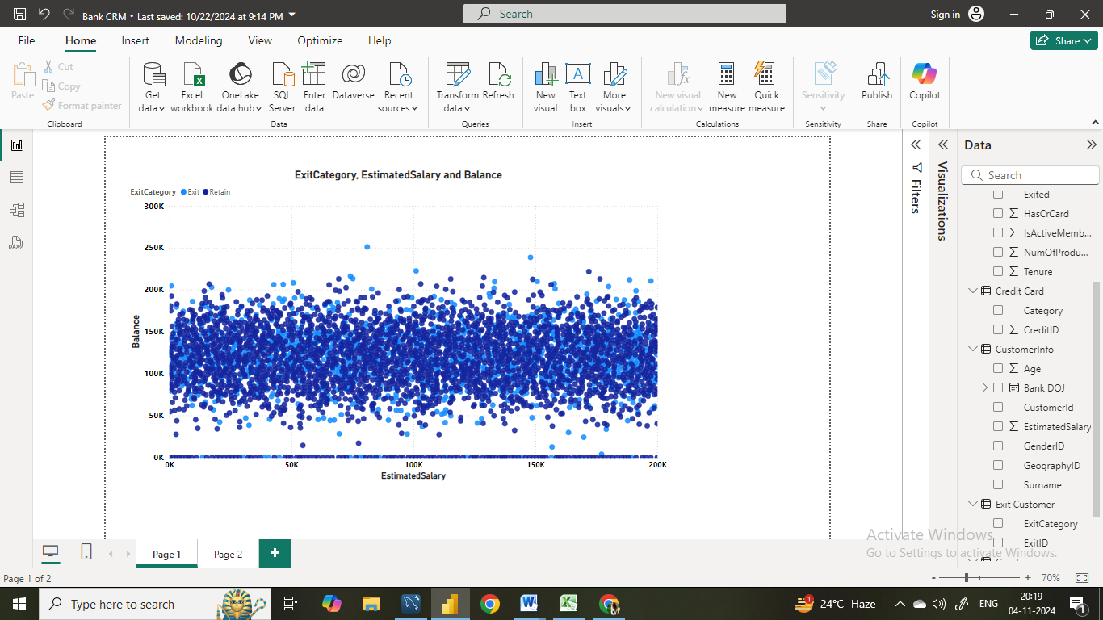
Salary vs. Balance
Here, by just looking to this chart we can say that there is no relationship between the salary and the balance of customers.
No correlation is found between the two.

Slide 11
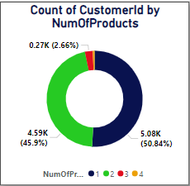
Product Affinity Study
Commonly used Product: Over 90% of the customers uses product 1 and 2.
Cross-Selling Potential: Customers using 1 product may benefit from targeted promotions.
Active Customer Engagement: Focus cross selling efforts on engaging customers.

Slide 12
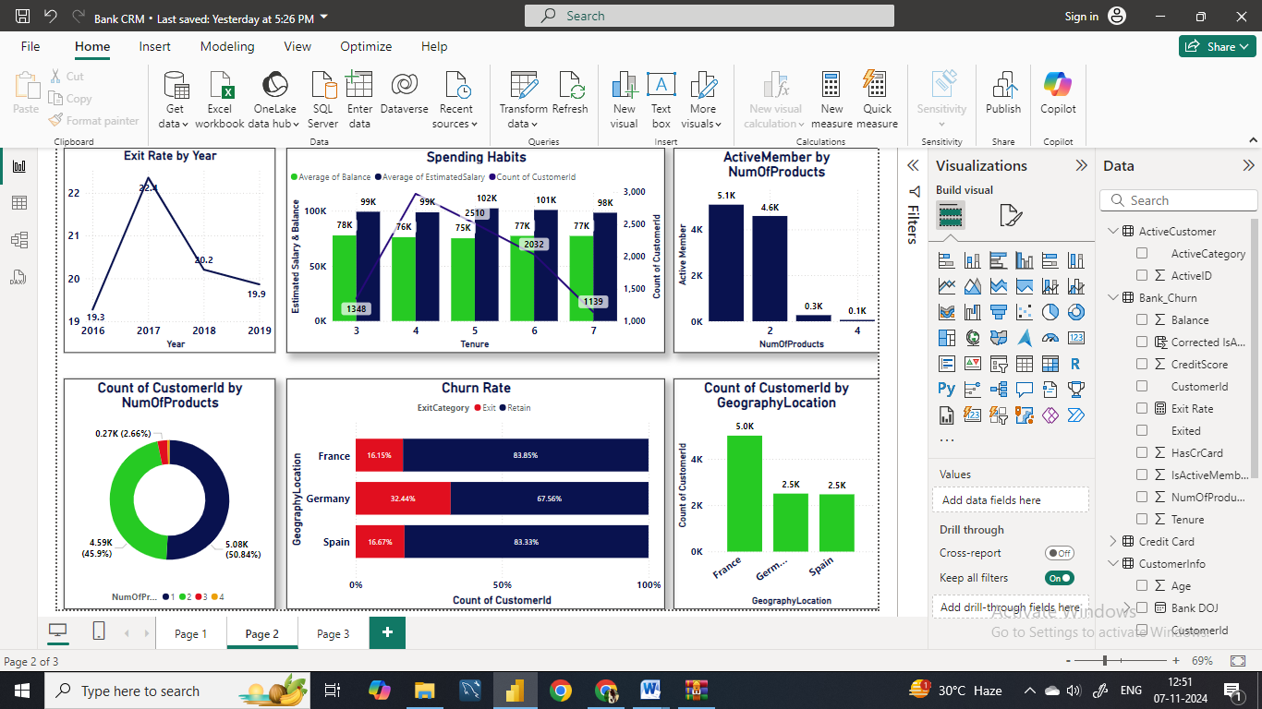
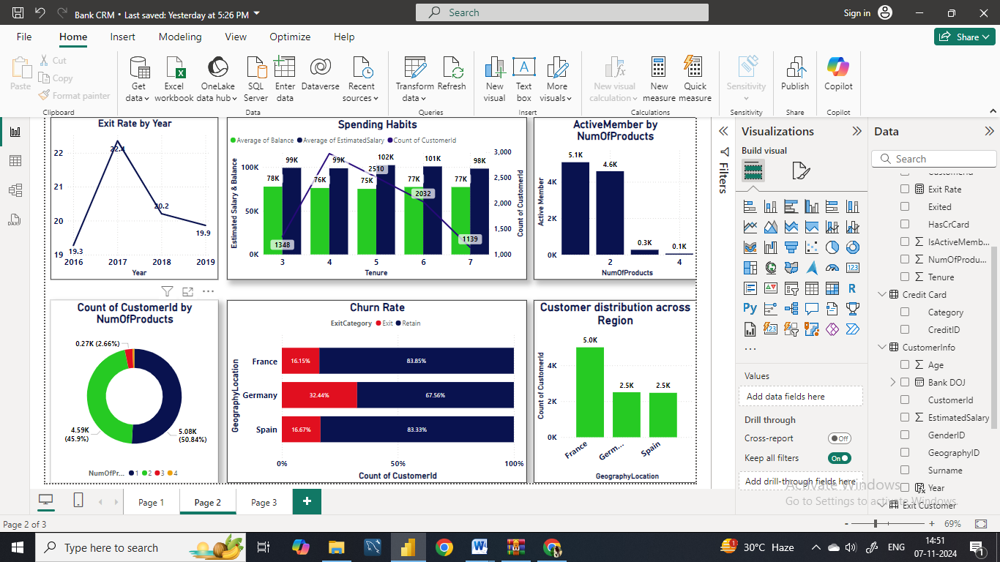
Geographic market trends
Customer Distribution across region:
France has the highest number of customers followed by Spain and Germany.
Churn Rates: In Germany there is the highest churn rate when compared t other regions.
Despite the churn rates, over 80% of the customers remain retained in various regions particularly, in France and Spain.

Slide 13
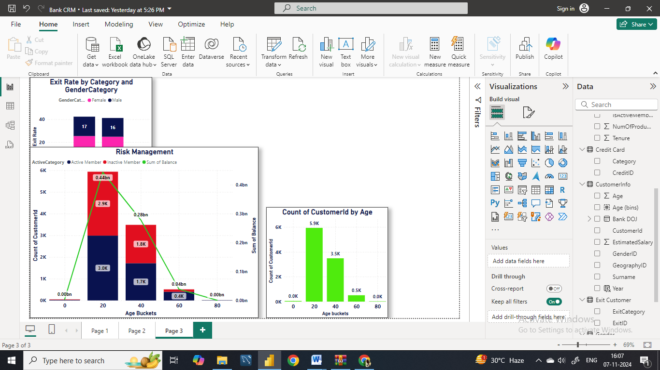
Risk Management Assessment
Since the younger age customers carry the higher balance the efforts to increase engagement and customer retention among inactive younger customer can be beneficial.
With the oldest age bucket the engagement strategies may not impact the bank’s overall balance but it can create the diverse growth opportunity.

Slide 14
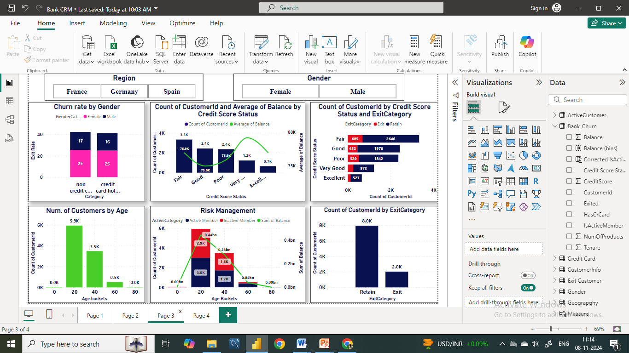
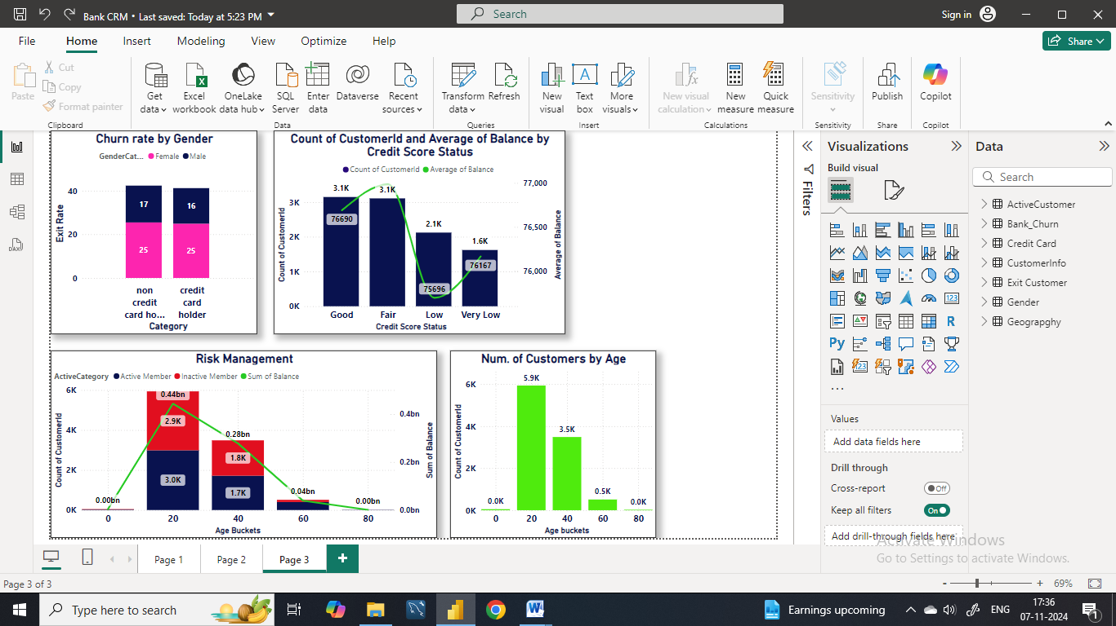
Customer Lifetime Value Forecast
Credit Card Usage and Exit Rates:
Lower exit rates among credit card holders.
Female customers have slightly higher exit rates.
Tenure and Financial Metrics:
Stable financial behavior over time.
Credit Score and Account Balance:
Higher credit scores linked to higher average balances.
Credit score not sole determinant of account balance.

Slide 15
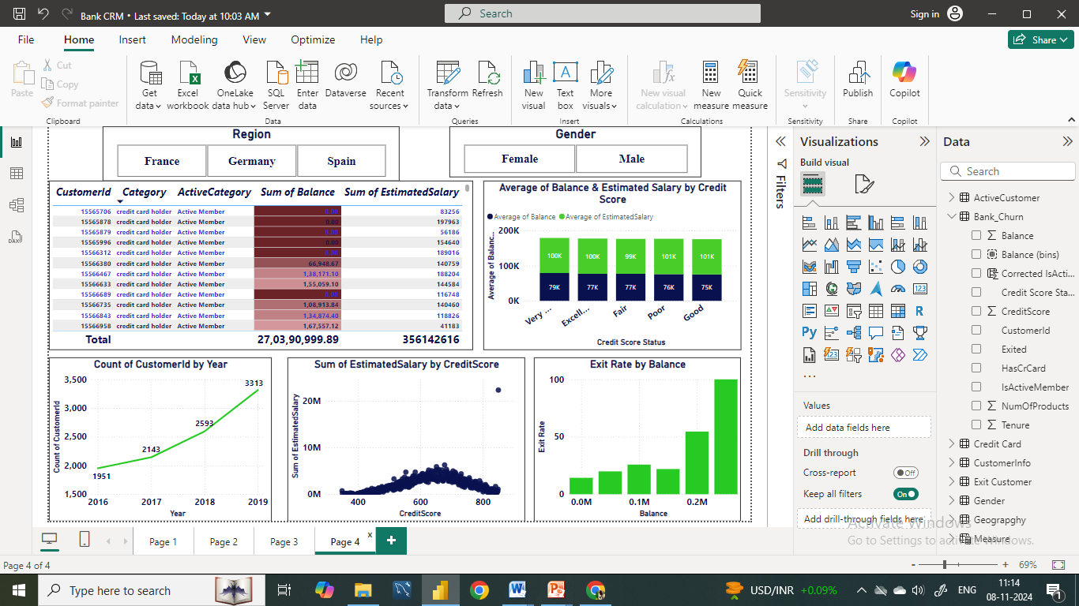
Marketing Campaign Effectiveness
Customer Segmentation: Customers were segmented based on their credit score ranges, including Excellent, Very Good, Good, Fair and Poor.
Customer with higher credit score tend to have higher account balance and estimated salary.

Slide 16
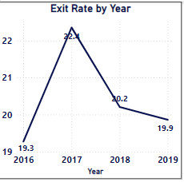
Campaign Effectiveness over Time
We observed variations in exit rates over the years 2016 to 2019.
In 2017, the exit rate was highest at 22.4%, followed by 2018 at 20.2%.
However, the exit rate decreased slightly in 2019 to 19.9%, suggesting potential fluctuations in customer churn rates in response to marketing campaigns over time.

Slide 17
Comparative Analysis
Here, we can see that Fair credit category has the higher exit rate followed by Poor category.
As per the number of customers we can see that in all the credit categories the retention rate is good enough.
Therefore we can say that the credit scores do not have any impact on churn rates.

Slide 18
Conclusion
Despite the increase in the number of customers over the years, the bank has experienced a consistent churn rate.
Middle age group customers have the highest churn rates, indicating specific retention challenges.
Improving customer engagement, enhancing customer service, and offering competitive products or services are key strategies to reduce churn.
Targeted marketing and personalized offers can help retain customers in critical age and credit score groups.
We have also seen that customer with highest average balance are more likely to churn, in this case targeted marketing and personalized offers can help in retaining those customers.
Overall, by focusing on customer engagement, service enhancement, and targeted strategies for specific customer segments, the bank can reduce churn, improve customer retention, and foster long-term customer loyalty.

Slide 19
Dashboard

Slide 20
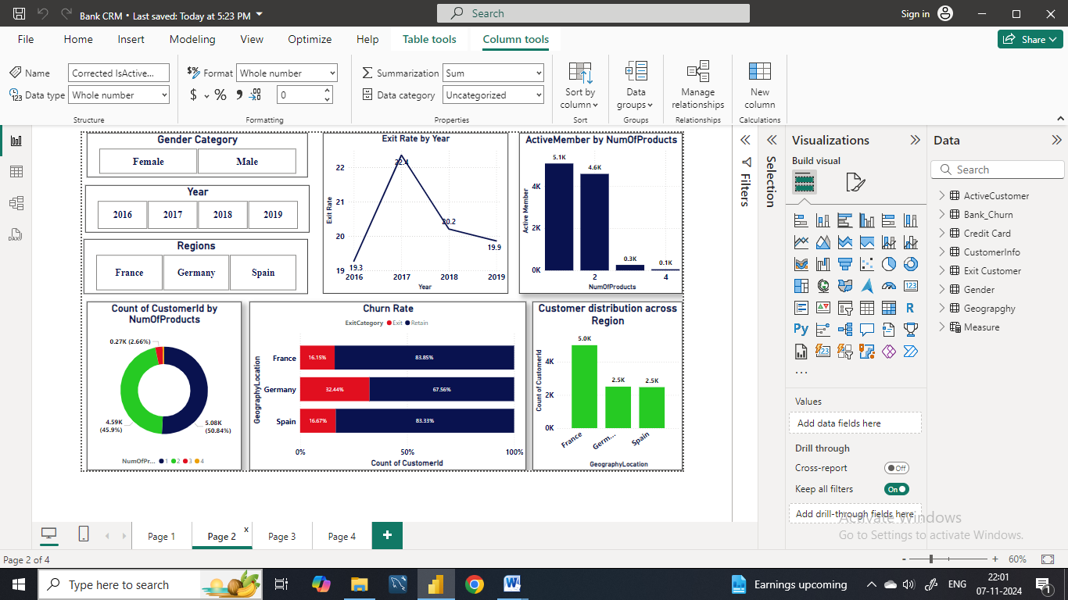

Slide 23
Reference
Data : From Newton School
Applications Used: MS Word, MS Power Point,
MySQL, Power BI.

Slide 24
Thank You

